Slide 1
Is My GPU Secure? Covert and Side Channel attacks on GPUs
Nael Abu-Ghazaleh
nael@cs.ucr.edu

Slide 2
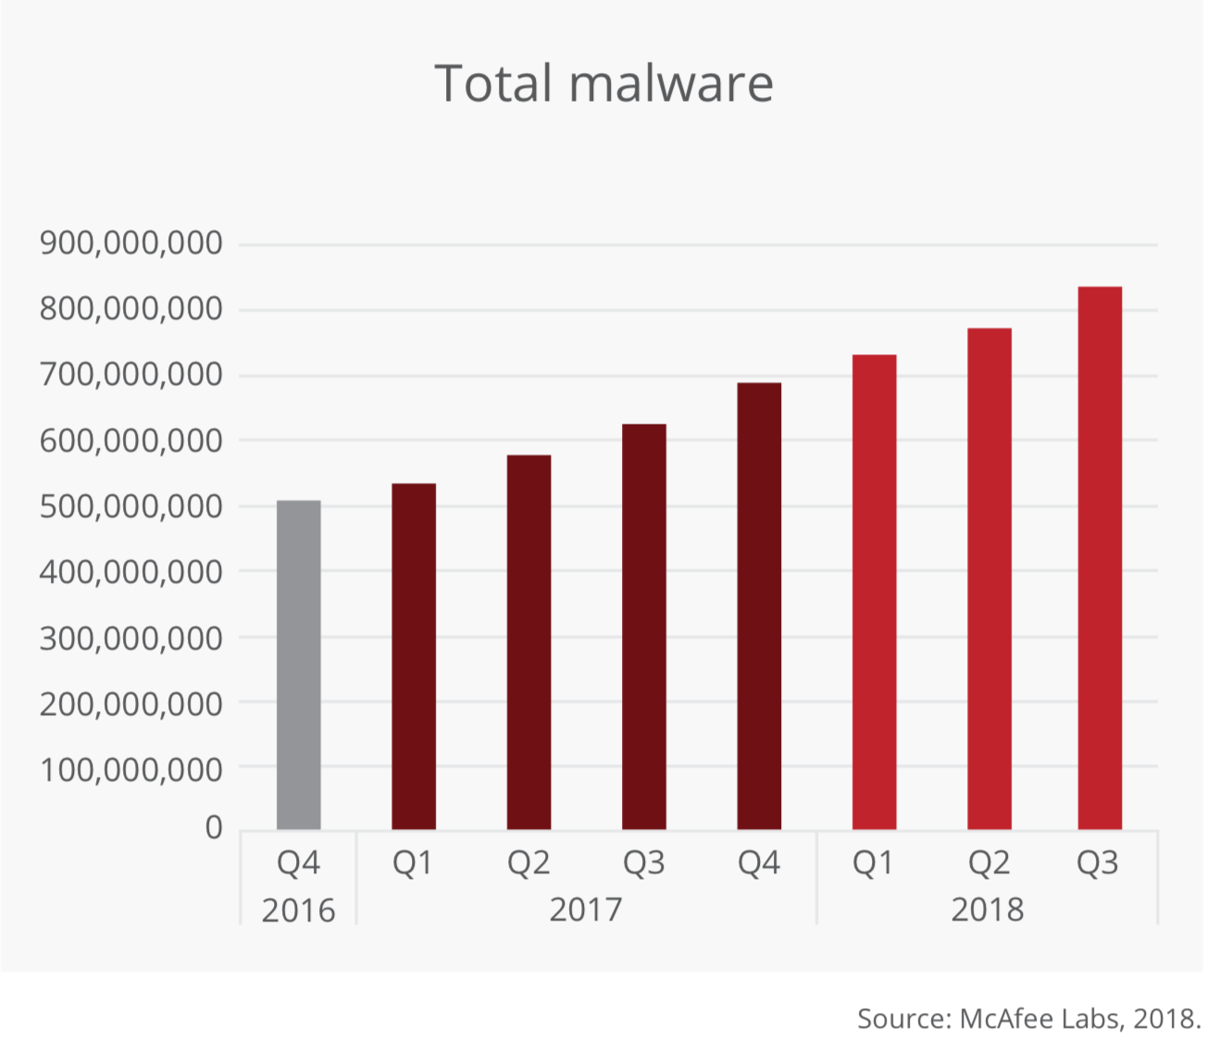
Malware is Everywhere!
Over 350,000 malware registered every day!
Notes:
The problem is that there is a lot of malware
These are what we see these days, but they are not always visible
Lets jump to what attackers really wants?

Slide 3


Slide 4


Slide 5
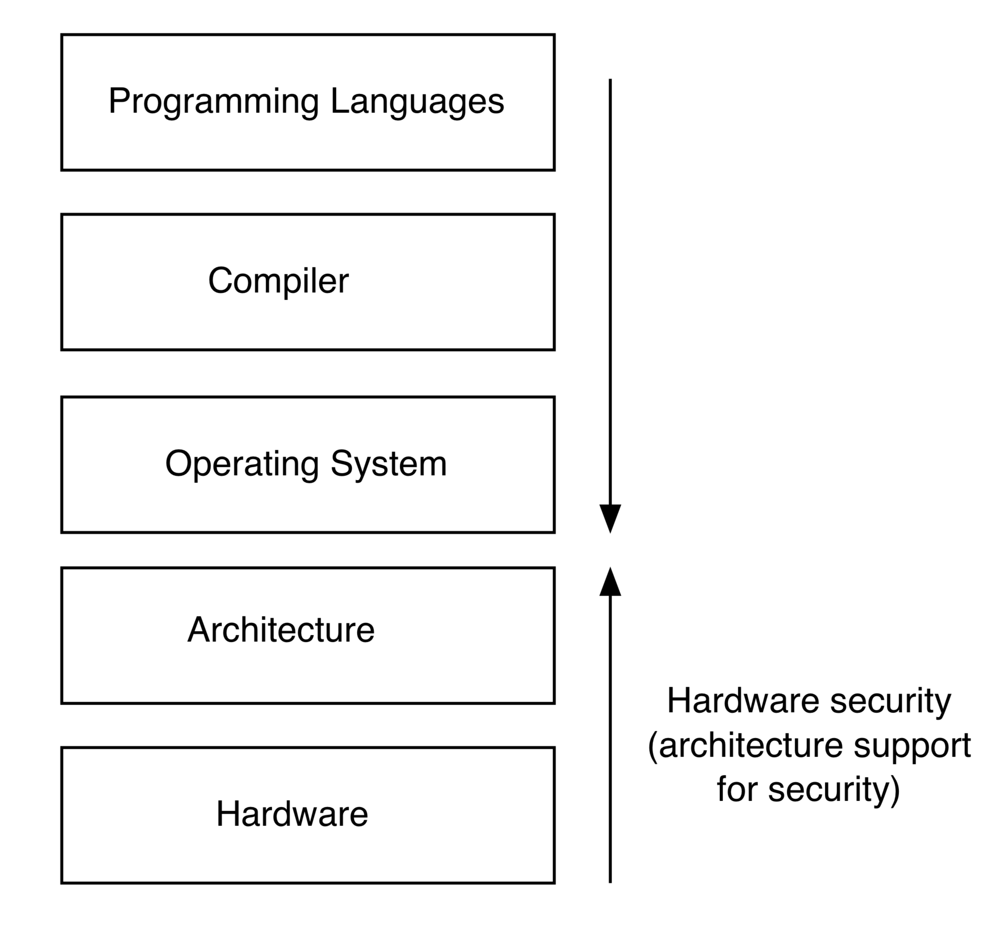
Architecture support for security
What hardware
Vulnerabilities are
Exploitable by software?
What support can we
offer to improve software
Security?

Slide 6
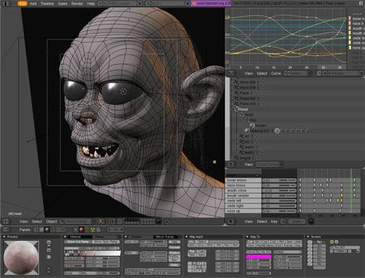


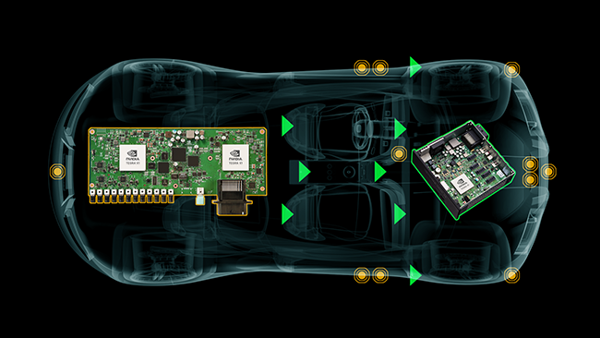
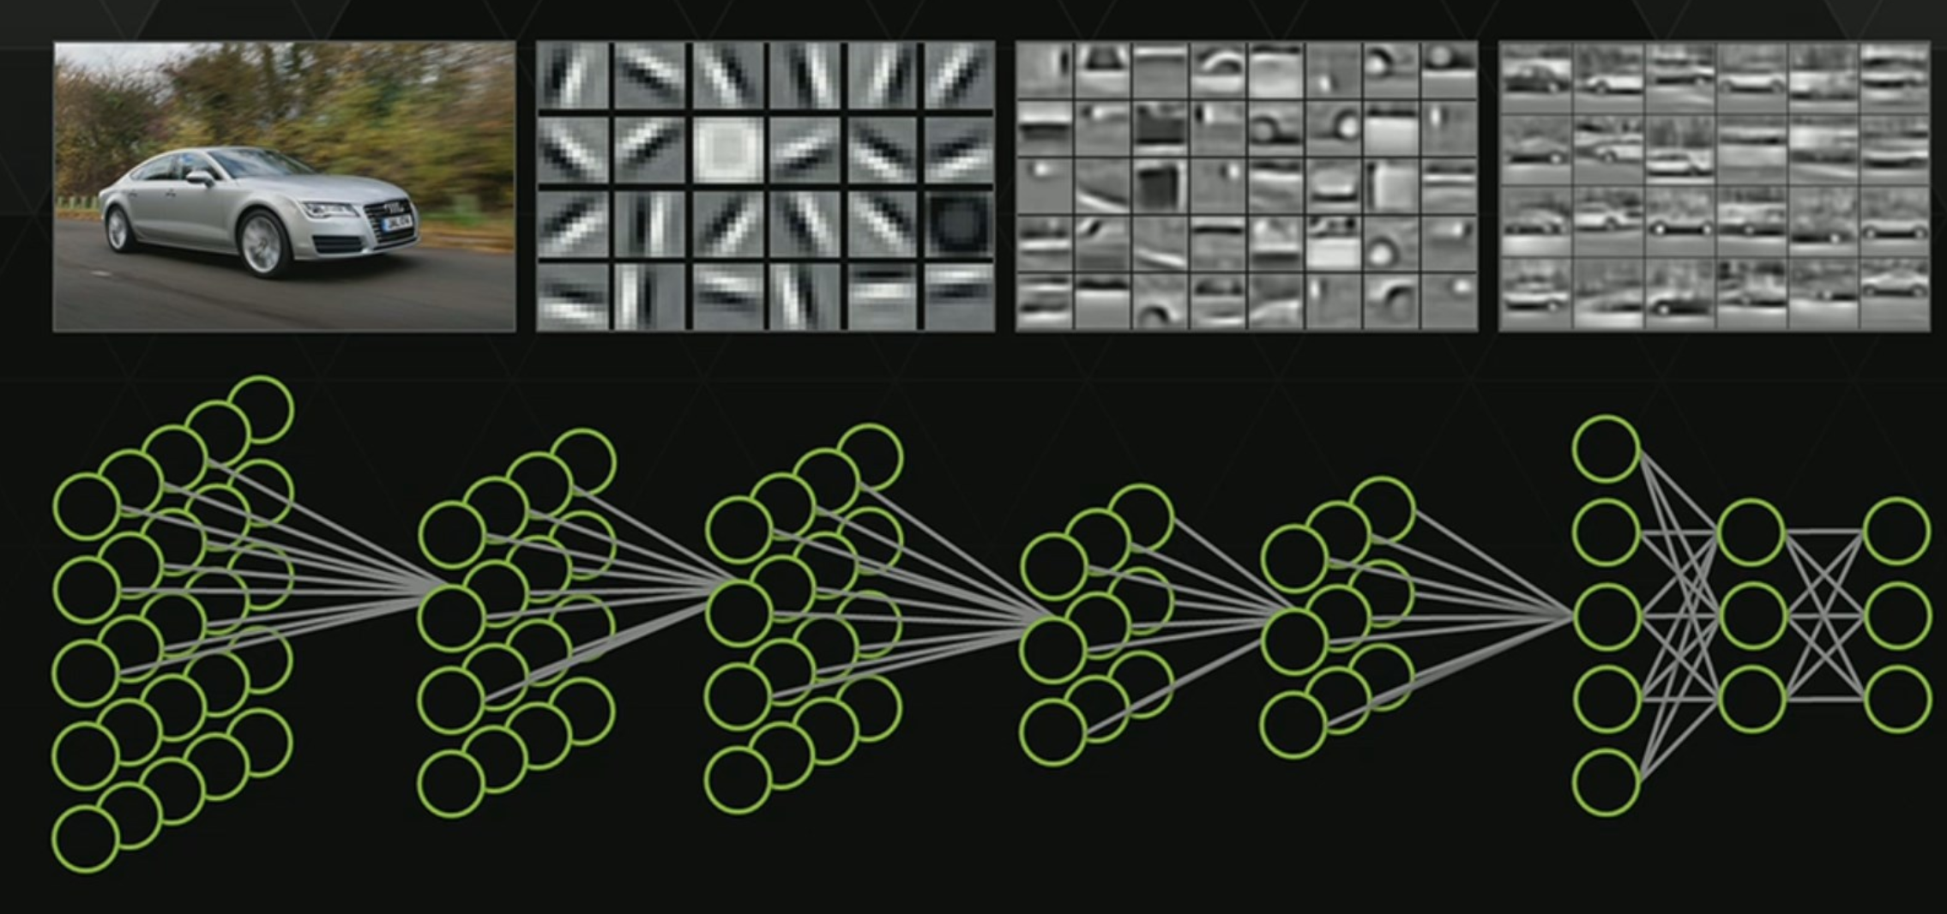

Graphics Processing Units
Optimize the performance of graphics and multi-media workloads
Integrated on data centers and clouds to accelerate compute
Embedded on autonomous vehicles, and other smart systems

Slide 7

Discrete GPUs (in Desktops, Clouds, Data Centers)
General Purpose Computation:
3D Graphics
(in Desktops)

Slide 8
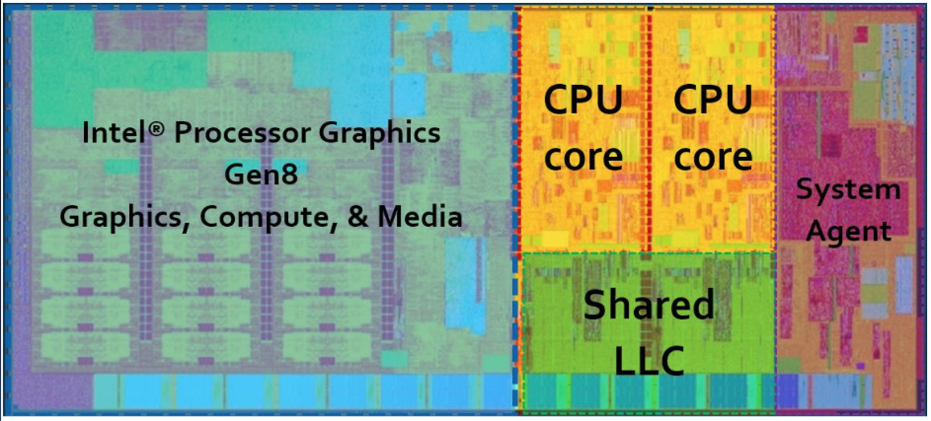
Integrated GPUs: (in Desktop, Laptops, Mobile SOCs)
Graphics
Computation
Embedded GPUs in CPS systems

Slide 9
Opportunities: Architecture & Security?
Vulnerabilities originating in architecture
Side and covert channels
Speculation attacks
Fault injection
Hardware trojans, …
Attacks
Defenses rooted in architecture
Do no harm
Avoid vulnerabilities in architecture/HW
Help software
Security abstractions/mechanisms
Computational support for expensive defenses
Defenses

Slide 10
Attacks based on GPU Leftover Memory
Stealing Webpages Rendered on Your Browser by Exploiting GPU Vulnerabilities (Lee et al., POSTECH)
key idea : Utilizing information leakage due to not clearing newly-allocated memory in the GPU to extract rearranged webpage textures of Chromium and Firefox web browsers
Confidentiality Issues on a GPU in a Virtualized Environment (Muarice et al.)
Key idea : leftover memory leakage in virtualized and cloud computing environments where the adversary launches a virtual machine after the victim’s virtual machine using the same GPU.
CUDA Leaks: A Detailed Hack for CUDA and a (Partial) Fix (Pietro et al.)
Key idea : Exploiting remnant state available in shared-memory, global-memory and registers.
S&P
2014
FC
2014
TECS
2016

Slide 11
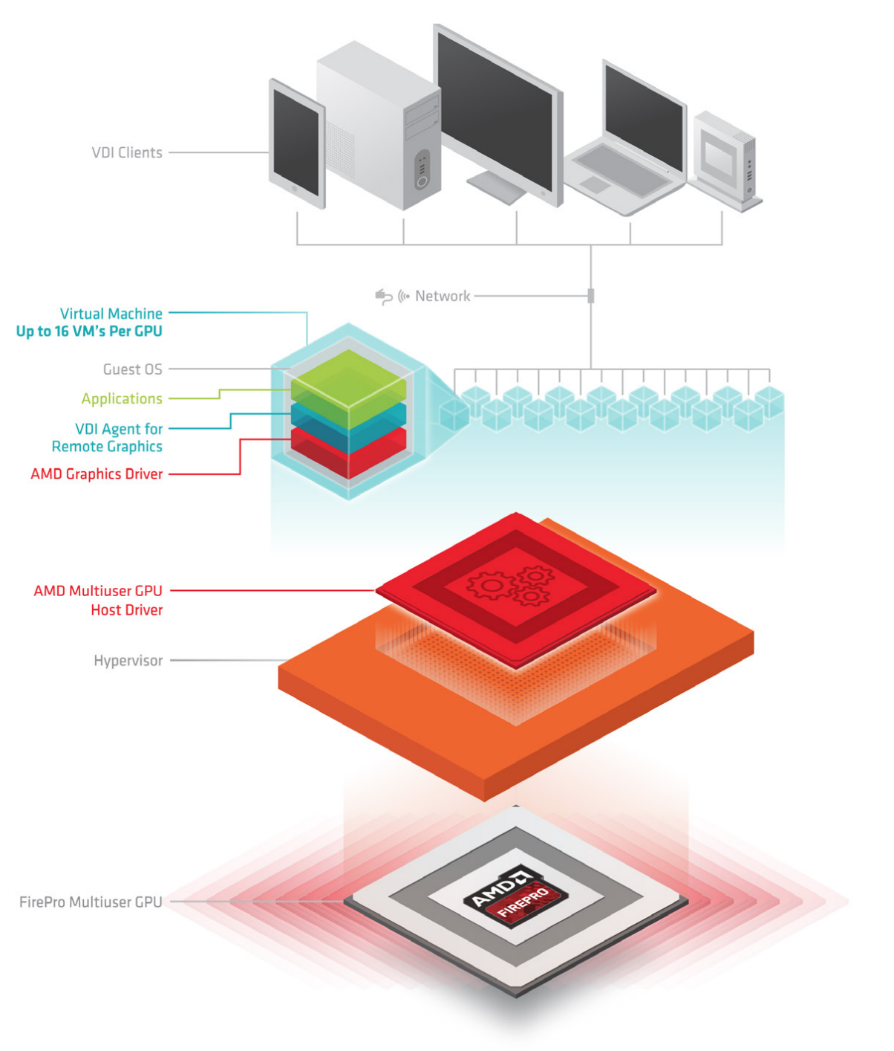
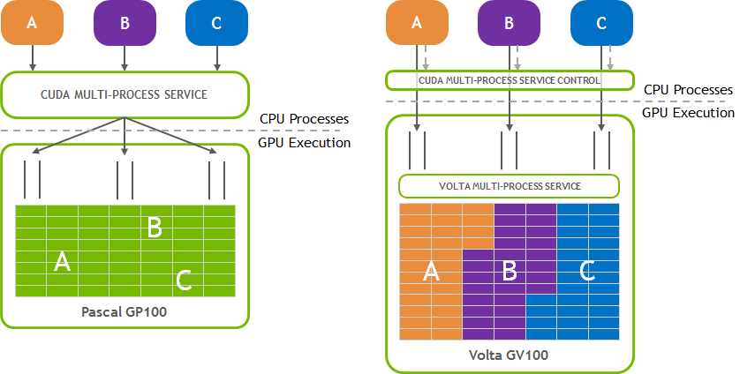
Multiprogramming on GPUs becoming widespread
Nvidia grid vGPU
Pascal asynchronous compute
Nvidia Volta Multi-Process Service (Each Volta MPS client owns its own GPU address space )
GPU Virtualization (Nvidia grid vGPU & AMD multiuser GPUs): Up to 16 client users share a GPU
Nvidia Pascal GPU supports asynchronous compute to concurrently run graphics and general purpose workloads.
AMD multiuser
Multi Process Service

Slide 12
Motivation
GPUs often process sensitive data
Trends to improve multiprogramming on GPUs
Are side channels a threat?
Covert channels shown
Some side channels, but not general

Slide 13
Outline
GPU Architecture and Programming Interfaces
Threat Model and Leakage Vectors
Side Channel Attacks:
Graphics-Graphics: Website Fingerprinting, Keystroke Timing attack
CUDA-CUDA: Neural Network model recovery
CUDA-Graphics: Website Fingerprinting
Mitigation

Slide 14
GPU Architecture: massive paralleism

Slide 15
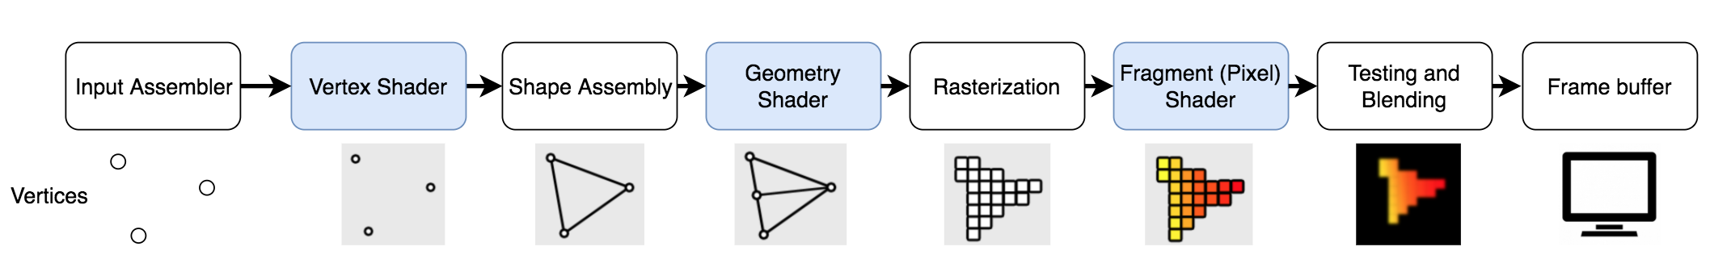
GPU Programming Interfaces
Computation: CUDA and OpenCL
Graphics: OpenGL and WebGL
Programmable steps of Graphics pipeline which are executed on SMs

Slide 16
Increasingly designed for sharing

Slide 17





Covert Channels on GPUs – Micro’17
Malicious indirect communication of sensitive data.
Why?
There is no communication channel.
The communication channel is monitored.
Covert channel is undetectable by monitoring systems on conventional communication channels.
Trojan
Spy
Covert Channel
Gallery App
Weather App

Slide 18
Colocation (Reverse Engineering the Scheduling)
Step 1: Thread block scheduling to the SMs
Kernel 1
Kernel 2
TB₀
TB₁
TB_{n}
TB₀
TB₁
TB_{n}
GPU
TB₀
TB₁
Thread Block Scheduler
TB₀
TB₁
TB_{n}
TB_{n}
Leftover Policy
SM₀
SM₁
SM_{m}
Interconnection Network
L2 Cache and Memory Channels

Slide 19
Step 2: Warp to warp schedulers mapping
TB
TB
W₀
W₁
W_{k-1}
W_{k}
W₀
W₁
W_{k-1}
W_{k}
Warp Scheduler
Warp Scheduler
TB_{i}
TB_{j}
SM_{k}
Dispatch Unit
Dispatch Unit
Register File
SP
SP
SP
DP
L/D
SFU
SP
SP
SP
DP
L/D
SFU
Shared Memory / L1 Cache

Slide 20
Colocation (Reverse Engineering the Scheduling)
Step 1: Thread block scheduling to the SMs
Kernel 1
Kernel 2
TB₀
TB₁
TB_{n}
TB₀
TB₁
TB_{n}
GPU
TB₀
TB₁
Thread Block Scheduler
TB₀
TB₁
TB_{n}
TB_{n}
Leftover Policy
SM₀
SM₁
SM_{m}
Interconnection Network
L2 Cache and Memory Channels

Slide 21
Step 2: Warp to warp schedulers mapping
TB
TB
W₀
W₁
W_{k-1}
W_{k}
W₀
W₁
W_{k-1}
W_{k}
Warp Scheduler
Warp Scheduler
TB_{i}
TB_{j}
SM_{k}
Dispatch Unit
Dispatch Unit
Register File
SP
SP
SP
DP
L/D
SFU
SP
SP
SP
DP
L/D
SFU
Shared Memory / L1 Cache

Slide 22
Attack Flow
Colocate Spy and Trojan
Construct the Channels
Remove Noise

Slide 23
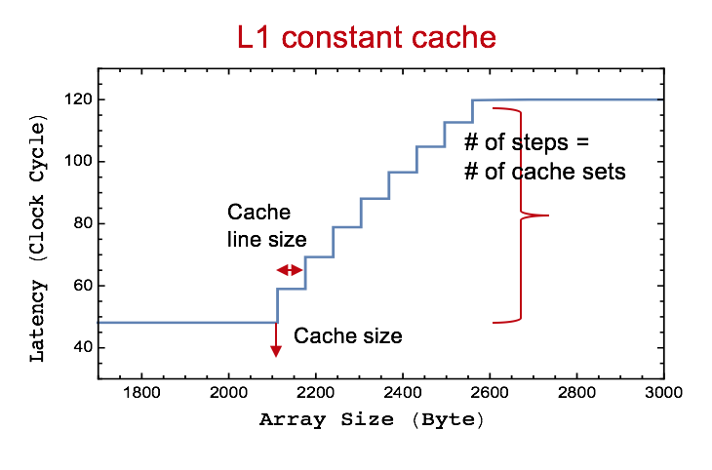

Cache Channel (intra-SM and inter-SM)
Extracting the cache parameters using latency plot.
(cache size, number of sets, number of ways and line size)
Communicating through one cache set.
Spy
Trojan
Eviction of Spy data
Send 0
Cache misses
Low Latency
Send 1
Cache Hit
Constant Cache set x
No Access!
Higher Latency
Constant Memory
Spy Data Array (SD)
Trojan Data Array (TD)

Slide 24
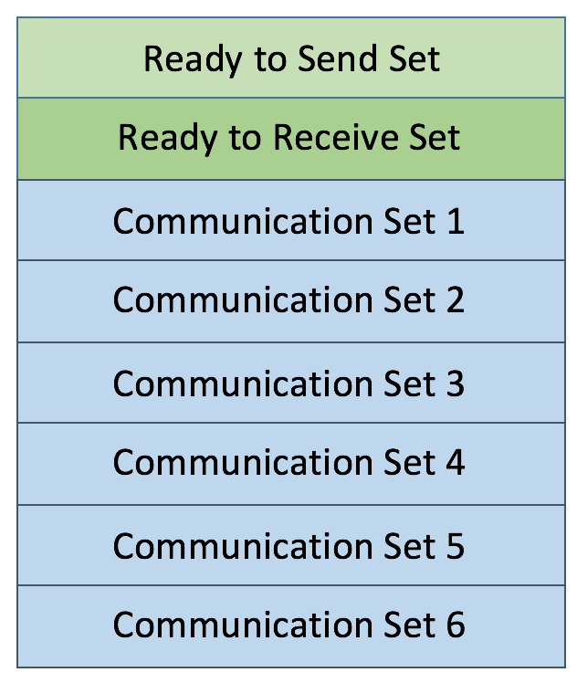
Synchronization:
L1 Constant cache
1
Wait (ReadytoSend)
Trojan
Wait (ReadytoReceive)
1
Spy
1
0
…011001
0
Receive 6 bits
Thread 0-5
1
Thread 0-5
1
0

Slide 25
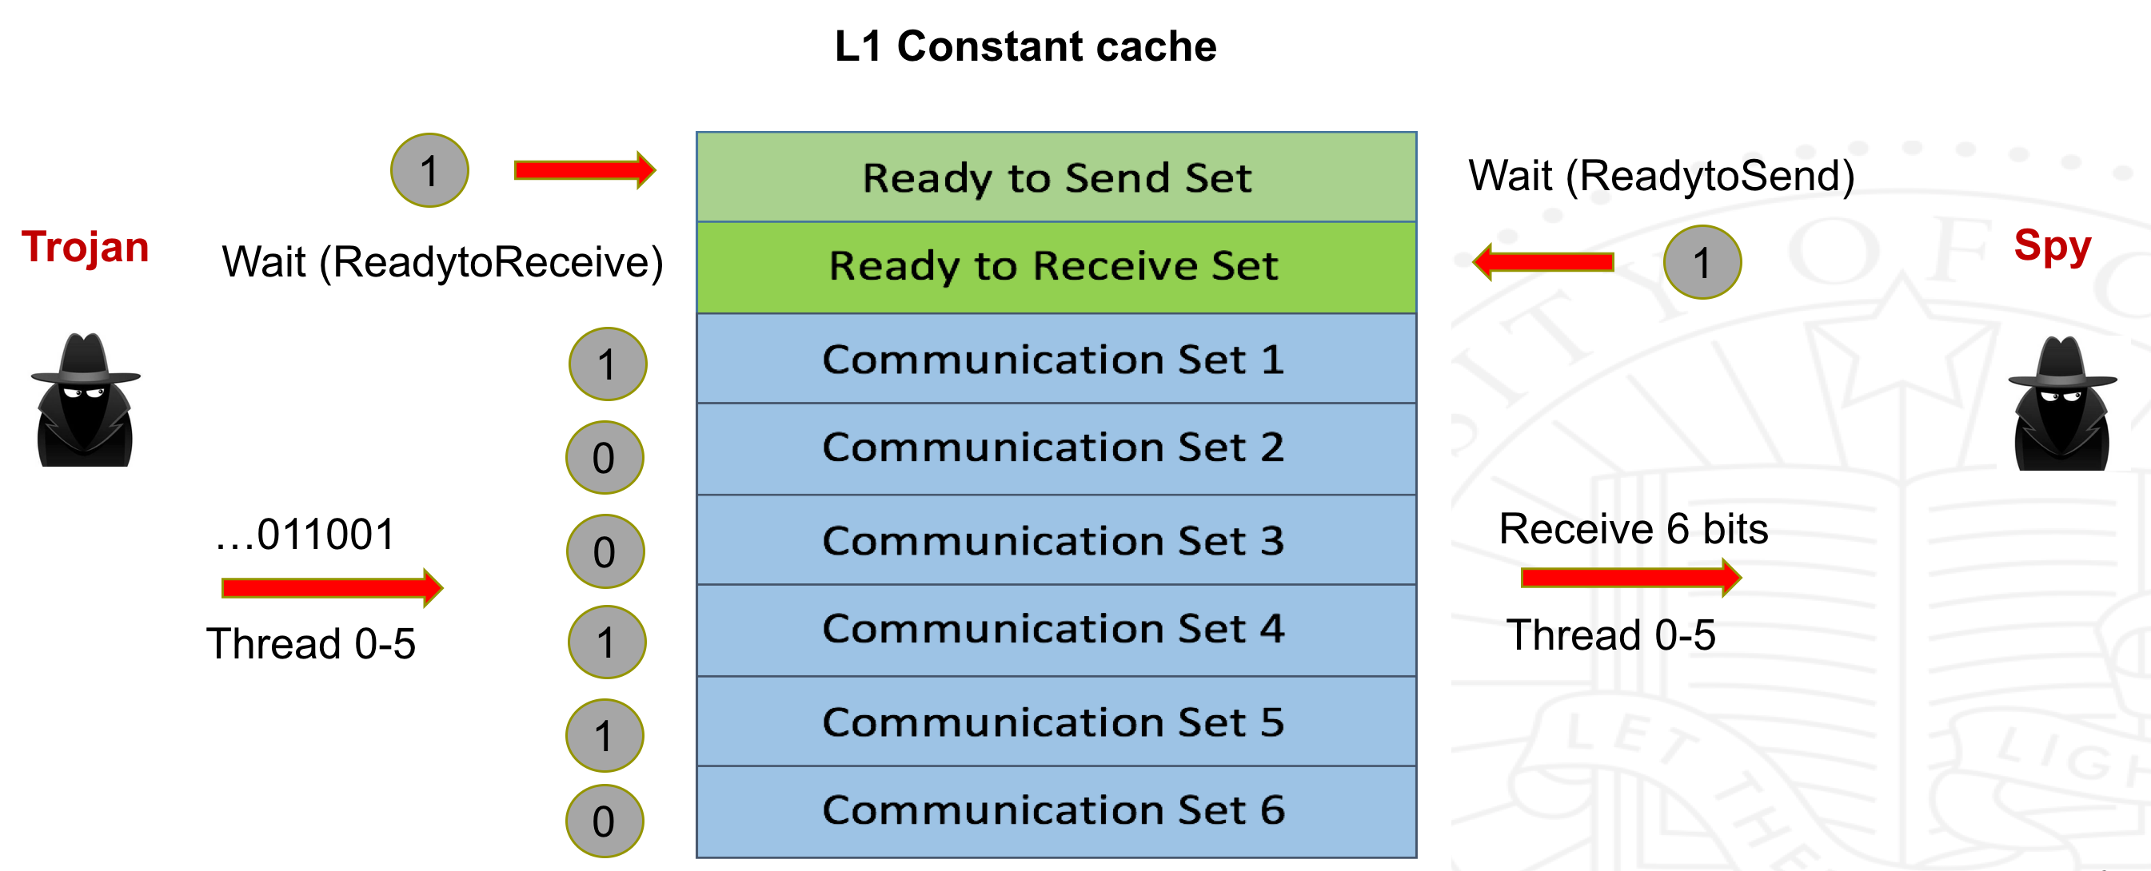
Synchronization and Parallelization
GPU
SM 0
SM 1
SM n
…

Slide 26
Exclusive Colocation of Spy and Trojan
Concurrency limitations on GPU hardware (leftover policy):
Shared Memory
Register
Number of Thread blocks
Spy
Trojan
TB₀
TB₁
TB_{n}
TB₀
TB₁
TB_{n}
Prevented interference from Rodinia Benchmark workloads on covert communication and achieved error free communication in all cases.
GPU
SM
Shared Memory
Spy
Shared Memory
…
Back Propagation
Register
Kmeans
Register
Trojan
Heart Wall
K-Nearest Neighbor
…
No Resource Left!

Slide 27
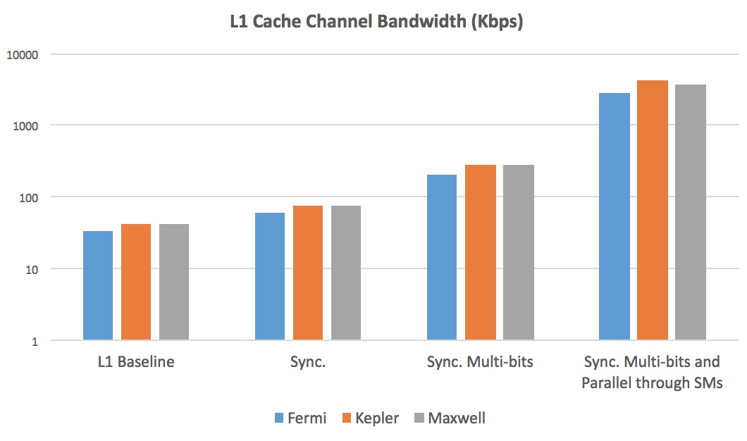
Performance
12.9 x
3.8 x
1.7 x
Error-free bandwidth of over 4 Mbps
Constructing and Characterizing Covert Channels on GPUs [Micro 2017]

Slide 28
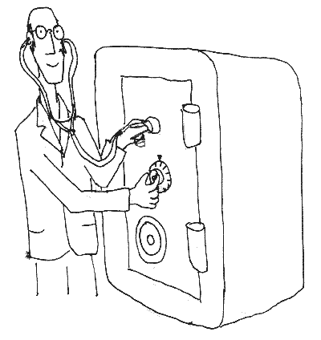
Side Channel
Side channels?

Slide 29
Finer grain microarchitectural channels
CPU
GPU
Concurrent apps not possible in all scenarios (e.g. Graphics and CUDA)
Possible on different
cores / same core
Co-location
Prime+Probe
Flush+Reload
…
Difficult (many active threads and small caches)
No flush instruction
D-cache attacks
Control flow
based attacks
I-cache attack
branch prediction attacks
SIMT computational model limits this leakage
No branch prediction

Slide 30

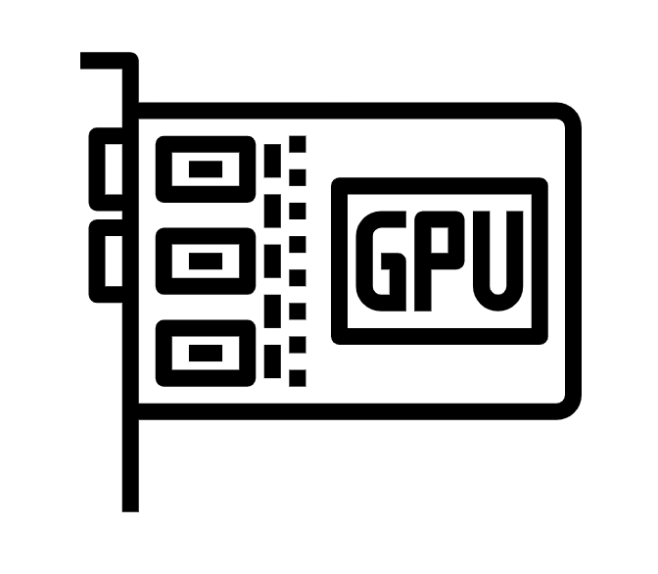

Threat Model
Programming Interfaces
Example Applications
GPU rendering
(Web Browsers, …)
GPU Accelerated Computations
(DNN, Encryption, …)
CUDA/OpenGL Spy
on
CUDA/OpenGL Victim
Key challenges:
How can attacker co-locate with victim
What leakage can be measured?
CUDA Spy
on
CUDA Victim
GPU Accelerated Computations
(DNN, Encryption, …)

Slide 31
Leakage Vectors
1
Memory allocation API : Exposes the amount of available physical memory on the GPU
GPU hardware performance counters: memory, instruction, multiprocessor, cache and texture metrics.
2
3
Timing operations: measuring the time of memory allocation events

Slide 32






Graphics-Graphics Attack Overview
OpenGL Spy
App
Screen
Rendering

Slide 33
Graphics-Graphics Side Channel (Co-location)
Reverse engineering the co-location of two concurrent applications:
Graphics App1
CPU Code
GPU Code (vertex and fragment shaders)
Two graphics applications whose workloads do not exceed the GPU hardware resources can colocate concurrently.
Graphics App2
CPU Code
GPU Code (vertex and fragment shaders)
CPU Code:
Read the pixel colors from framebuffer and decode the information
GPU Code (fragment shader):
Use OpenGL extensions to read ThreadID, WarpID, SMID and clock of each fragment (pixel/thread) on the GPU and encode this information in the color of each pixel.
glReadPixels(…);
SMID = float(gl_SMIDNV)/3.0;
clock = float(clock2x32ARB().y)/4294967295.0;
ThreadID = float(gl_ThreadInWarpNV)/32.0;
color = vec4(0, ThreadID ,SMID, clock);

Slide 34

Attack 1: Website Fingerprinting
Current versions of web browsers utilize the GPU to accelerate the rendering process.
A content-related pattern (depending on the size and shape of the object) of memory allocations is performed on the GPU.
Uploading objects as Textures to the GPU
Rendering

Slide 35
GPU memory allocation trace
OpenGL: query
“GPU_MEMORY_INFO_CURRENT_AVAILABLE_VIDMEM_NVX”
Same attack can be done by a CUDA spy using CUDA API:
“cudaMemGetInfo”

Slide 36
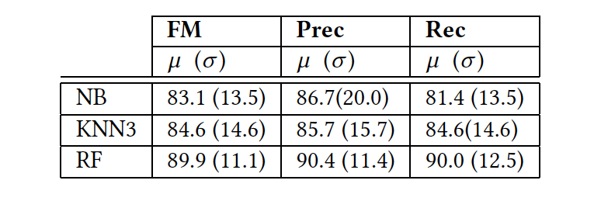
Classification Results
The classification results for Memory API based website fingerprinting attack on 200 Alexa Top Websites:
Gaussian Naive Bayes (NB)
K-Nearest Neighbor with 3 neighbors (KNN-3)
Random Forest with 100 estimators (RF)

Slide 37
Attack 2: Keystroke Timing
Record the timing of memory allocation events
Password bar is rendered at constant rate, when user is not typing
Password bar is rendered when user types a character
6-character password

Slide 38
Keystroke timing: Ground Truth vs. GPU
The probability density of the normalized measurement error with 250 key presses/timing samples
The inter-keystroke timing for 25 pairs of characters being typed

Slide 39

CUDA-CUDA: Attack overview
CUDA App
CUDA Spy
App

Slide 40
CUDA-CUDA Side Channel
Colocation:
Multi-Process Service (MPS) on NVIDIA GPUs allows execution of concurrent kernels from different processes on the GPU
Leakage:
Monitoring GPU Performance Counters provided by NVIDIA profiling tools
MPI Process A
MPI Process B
MPS Client Context A
MPS Client Context B
Many to one context
Server CUDA Context
MPI Service Process
Concurrent
Scheduler
Concurrent
Scheduler
Time-Sliced
Scheduler
Processors
GPU

Slide 41
Attack 3: Neural Network Model Recovery
Victim: A CUDA-implemented back-propagation (Rodinia benchmark)
Spy: Launches several hundred consecutive CUDA kernels
Methodology:
Colocate: Reverse engineer GPU hardware schedulers to colocate on each SM
Create contention: Different threads (or warps) utilize different hardware resources in parallel to create contention
Measure: Collecting one vector of performance counter values from each spy kernel

Slide 42
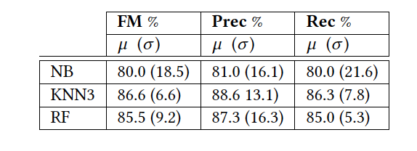
Results
The classification results for identifying the number of neurons through the side channel attack:
Input layer size varying in the range between 64 and 65536 neurons collecting 10 samples for each input size

Slide 43
CUDA-Graphics Side Channel
Colocation (reverse engineering):
Fine-grained interleaving execution (not concurrent) of CUDA kernels and graphics operations on the GPU
Leakage:
Memory API
From CPU, so concurrent execution
GPU Performance Counters sampling after every frame by a short CUDA kernel
Result: Classification accuracy of 93% for 200 Alexa top websites

Slide 44
Disclosure to NVIDIA
We have reported all of our findings to NVIDIA
Security bulletin, and CVE string
Patch: offers system administrators the option to disable access to performance counters from user processes
Appears to be a substantial compatibility issue to take away these APIs

Slide 45
Recap
Side channels on GPUs
Fine grain channels impractical?
…between two concurrent applications on GPUs:
A series of end-to-end GPU attacks on both graphics and computational stacks, as well as across them.
Mitigations based on limiting the rate and precision are effective
Future work: Multi-GPU systems; integrated GPU systems

Slide 46
Architecture Mitigations

Slide 47
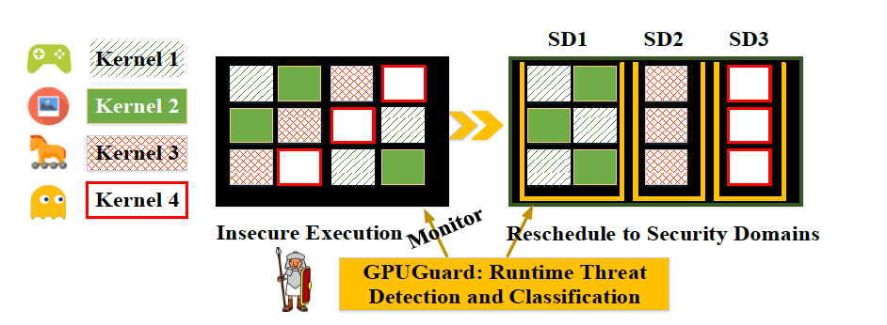
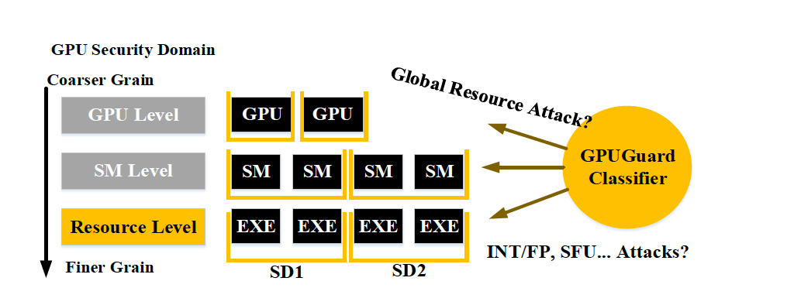
Mitigating Contention Based Side and Covert Channel Attacks on GPUs
GPUGUARD
Classifier to detect contention
Security domains at different hierarchy levels
maximize sharing (and performance) when it is safe

Slide 48
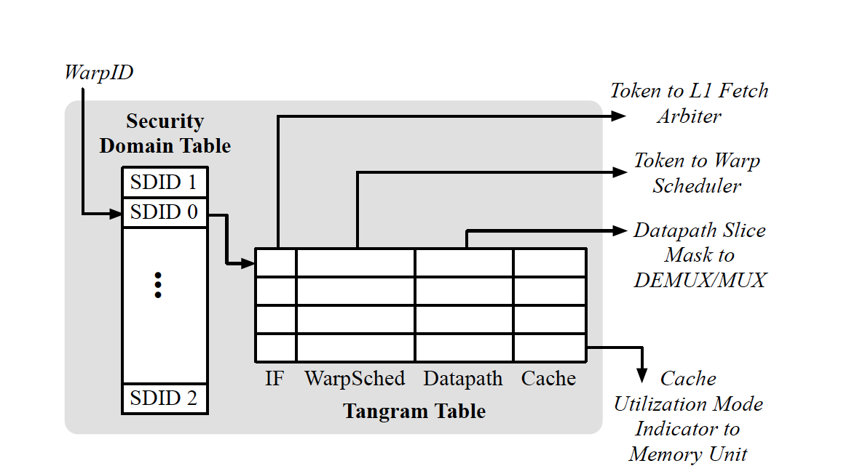
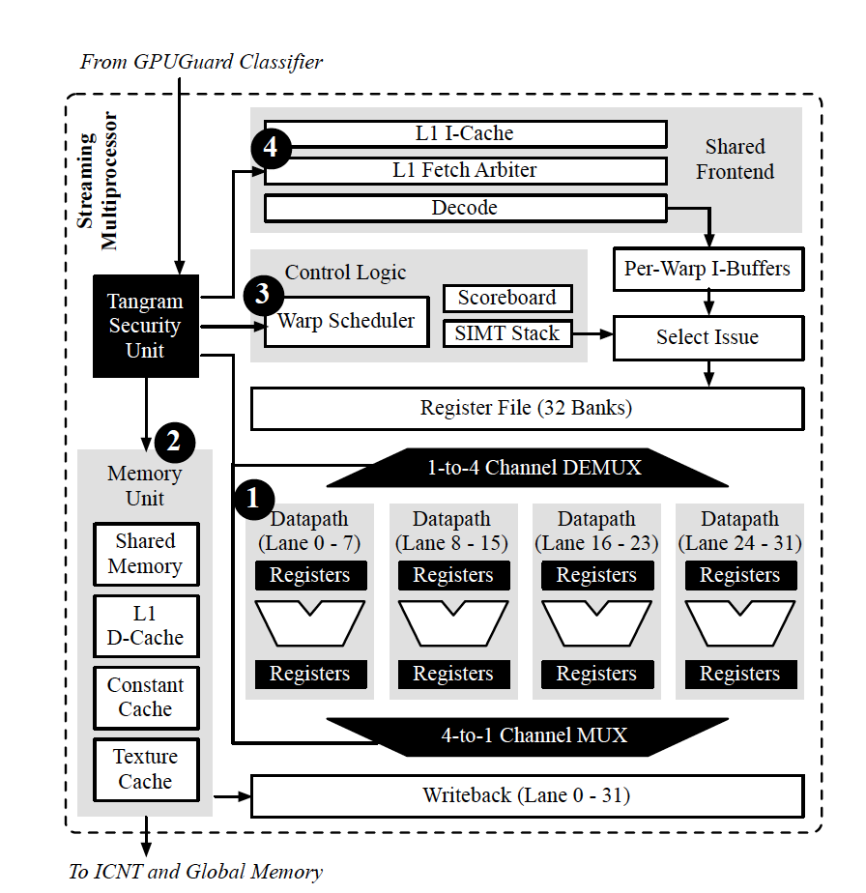
Security Unit Implementation:
Tangram (Intra-SM Defense Framework)
Tangram Security Unit
Datapath Slicing to Prevent Functional Unit Attacks
Rate Limiting Warp Scheduler to Prevent Warp Scheduling Attack
Instruction Fetch Arbitration to Prevent Instruction Cache Attack
Data Cache Re-purposing and Bypassing to Prevent Data Cache Attack.
Temporal Partitioning to Prevent Global Memory Attack

Slide 49
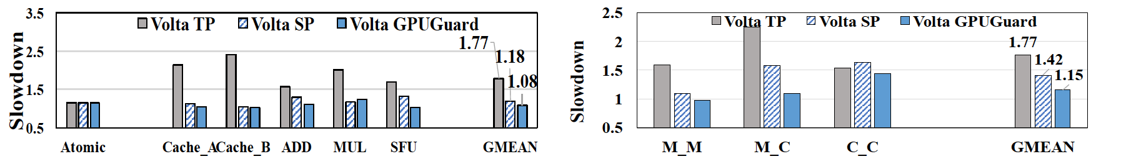
Results
Performance impact of GPUGuard on Volta.
Attacks
Regular Apps
Detection: 100% sensitivity, 8.5% false positive rate and 0% false negative rate.
8% to 23% overhead when there is an attack and zero overhead under attack
69%-96% faster than spatial partitioning.
0.2% area overhead. 0.18% of the overall system power.

Slide 50
Mitigation
Limiting the rate of the calls
Limiting the precision of returned information
Combined
(Rate limiting at 4MB granularity)

Slide 51
Mitigating GPU Timing Attack via Subwarp-based Randomized Coalescing Techniques Kadam, Zhang and Jog (College of William and Mary & Penn State University)
RCOAL
HPCA-2018
Defense to “A Complete Key Recovery Timing Attack on a GPU; Jiang, Fei, Kaeli, Northeastern University”
The attack uses the deterministic nature of the coalescing mechanism
Making the calculation of coalesced accesses harder for the attacker by randomizing the memory access coalescing (the size, number, and thread-elements of a sub-warp)
A trade-off between security and performance

Slide 52
Memory Access Coalescing in GPUs
WARP
sid = subwarp id
tid = thread id
sid = 0
sid = 0
sid = 0
sid = 0
tid = 0
tid = 1
tid = 2
tid = 3
0x00
0x04
0x07
0x09
Block Address # 0
0x00
0x01
0x02
0x03
Block Address # 1
0x04
0x05
0x06
0x07
Block Address # 1
0x04
0x05
0x06
0x07
Block Address # 2
0x08
0x09
0x0A
0x0B
Slide credit: Kadam et al. , HPCA 2018

Slide 53
Memory Access Coalescing in GPUs
WARP
sid = subwarp id
tid = thread id
sid = 0
sid = 0
sid = 0
sid = 0
tid = 0
tid = 1
tid = 2
tid = 3
0x00
0x04
0x07
0x09
SUBWARP
Coalescing Unit
Block Address # 0
0x00
0x01
0x02
0x03
Block Address # 1
0x04
0x05
0x06
0x07
Block Address # 2
0x08
0x09
0x0A
0x0B
Slide credit: Kadam et al. , HPCA 2018

Slide 54
1
RCoal: Fixed Sized Subwarp (FSS)
DEFAULT: number of subwarps = 1
FSS: number of subwarps = 2
Security Improves, Performance Degrades
sid = 0
sid = 0
sid = 0
sid = 0
sid = 0
sid = 0
sid = 1
sid = 1
tid = 0
tid = 1
tid = 2
tid = 3
tid = 0
tid = 1
tid = 2
tid = 3
0x00
0x04
0x07
0x09
0x00
0x04
0x07
0x09
Coalescing Unit
Coalescing Unit
0x00
0x01
0x02
0x03
0x00
0x01
0x02
0x03
0x04
0x05
0x06
0x07
0x04
0x05
0x06
0x07
0x04
0x05
0x06
0x07
0x08
0x09
0x0A
0x0B
0x08
0x09
0x0A
0x0B
Slide credit: Kadam et al. , HPCA 2018

Slide 55
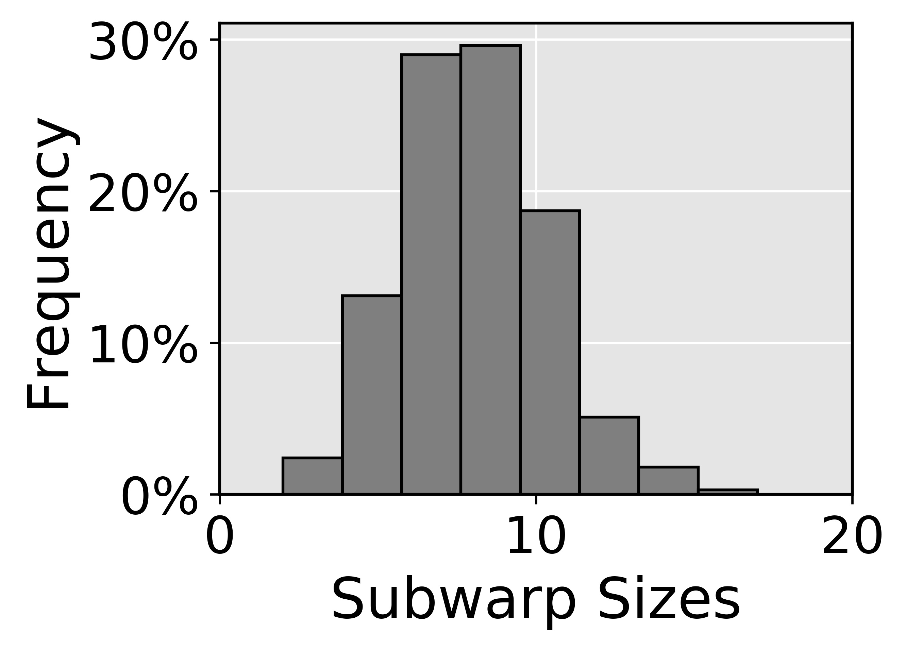
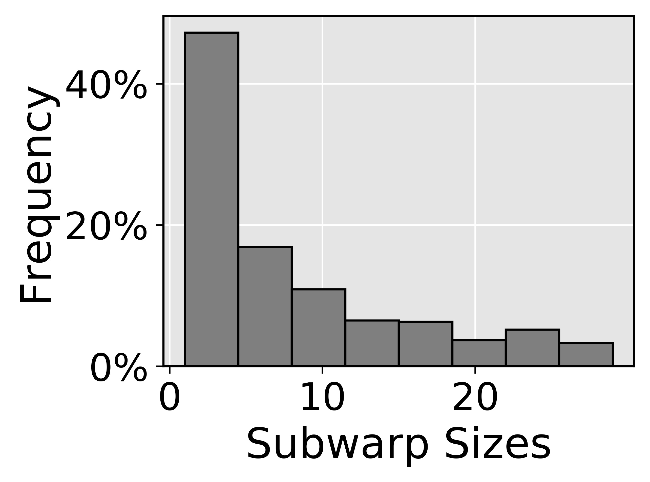
RCoal: Random Sized Subwarp (RSS)
2
Size distribution
We select RSS with Skewed Distribution
✗
✓
Normal Distribution
Skewed Distribution
Mean of the distribution is same as FSS
Security and performance similar to FSS
Mean of the distribution is different than FSS
Large subwarp offers better coalescing
Improved security compared to FSS
Improved performance compared to FSS
Slide credit: Kadam et al. , HPCA 2018

Slide 56
Random-Threaded Subwarp (RTS)
3
FSS: number of subwarps = 2
FSS+RTS: number of subwarps = 2
sid = 0
sid = 0
sid = 1
sid = 1
sid = 0
sid = 1
sid = 0
sid = 1
tid = 0
tid = 1
tid = 2
tid = 3
tid = 0
tid = 1
tid = 2
tid = 3
0x00
0x01
0x06
0x07
0x00
0x01
0x06
0x07
Coalescing Unit
Coalescing Unit
0x00
0x01
0x02
0x03
0x00
0x01
0x02
0x03
0x00
0x01
0x02
0x03
0x04
0x05
0x06
0x07
0x04
0x05
0x06
0x07
0x04
0x05
0x06
0x07
Slide credit: Kadam et al. , HPCA 2018

Slide 57
RCoal: Random-Threaded Subwarp (RTS)
RSS: number of subwarps = 2
RSS+RTS: number of subwarps = 2
sid = 0
sid = 1
sid = 1
sid = 1
sid = 1
sid = 1
sid = 0
sid = 1
tid = 0
tid = 1
tid = 2
tid = 3
tid = 0
tid = 1
tid = 2
tid = 3
0x00
0x01
0x06
0x08
0x00
0x01
0x06
0x08
Coalescing Unit
Coalescing Unit
0x00
0x01
0x02
0x03
0x00
0x01
0x02
0x03
0x00
0x01
0x02
0x03
0x04
0x05
0x06
0x07
0x04
0x05
0x06
0x07
0x08
0x09
0x0A
0x0B
0x08
0x09
0x0A
0x0B
Slide credit: Kadam et al. , HPCA 2018

Slide 58
Results
Security
(Lower the better)
RCoal_Score
Execution Time
(Lower the better)
RCoal improves security by 24- to 961- times at a modest performance loss of 5 to 28%.
Slide credit: Kadam et al. , HPCA 2018

Slide 59
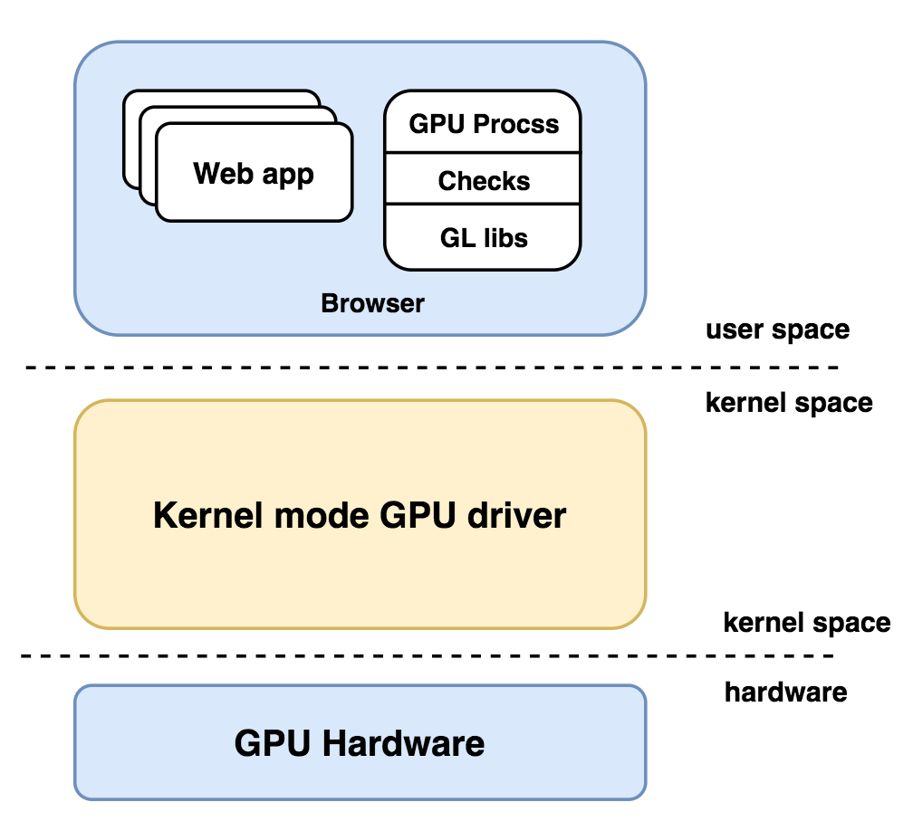
Sugar: Secure GPU Acceleration in Web Browsers Yao, Ma, Liu, Amiri Sani and Chandramowlishwaran, University of California, Irvine
ASPLOS 2018
Current WebGL design
WebGL exposes a large Trusted Computing Base (TCB) to web apps, which are untrusted
GPU driver is buggy
Kernel driver is compromised
Vulnerabilities in GPU Process
Security checks in GPU Process is not enough, cannot protect against zero-day exploits

Slide 60
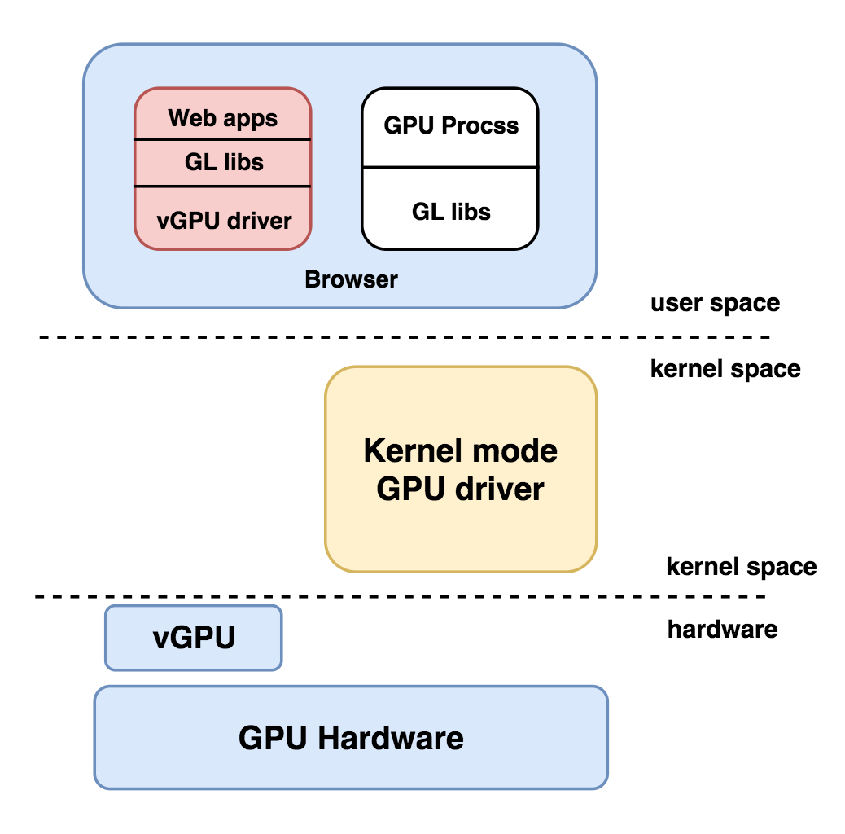
Sugar:
Sugar’s design
Key idea: Use GPU virtualization to give an untrusted web app a separate vGPU
A dedicated virtual GPU (or vGPU) as well as all the software graphics stack (including the device driver))
Web app process is sandboxed
vGPU is isolated
Sugar’s TCB is small
Function call
Function call

Slide 61
Future Directions
Integrated GPUs
Remote WebGL-based
Attacks
Multi-GPU systems
in HPC Clusters

Slide 62
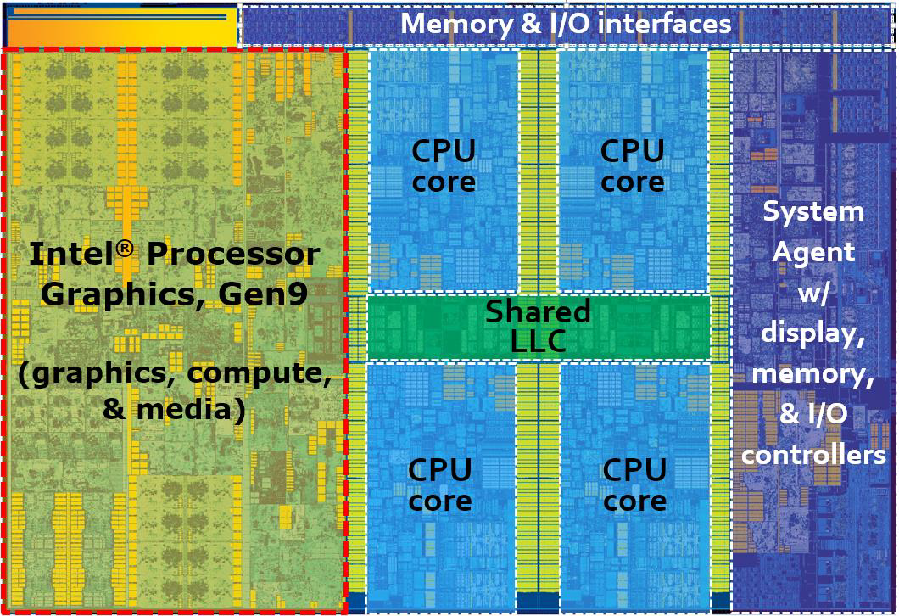
Integrated GPUs (Desktops, laptops and Smart Phones)
Modern SOCs: multiple CPU cores along with Integrated GPU

Slide 63
Integrated GPUs
Memory, EDRAM and LLC are shared between CPU and GPU
Possible Threat Models:
Cross-Component Covert and Side Channels
Rowhammer on EDRAM

Slide 64
Covert Channels
CPU-GPU share the Last-Level Cache
GPU as Trojan and CPU as Spy
Motivation: Bypassing existed mitigations on GPU and CPU for Covert Channel detection and defense
Challenge: No clock function inside OpenCL kernel =>
using Shared Virtual Memory (SVM) and Zero-Copy (Same physical memory)
Reverse engineering the LLC on CPU side of GPU Process
Focus on One LLC set to improve the bandwidth.

Slide 65
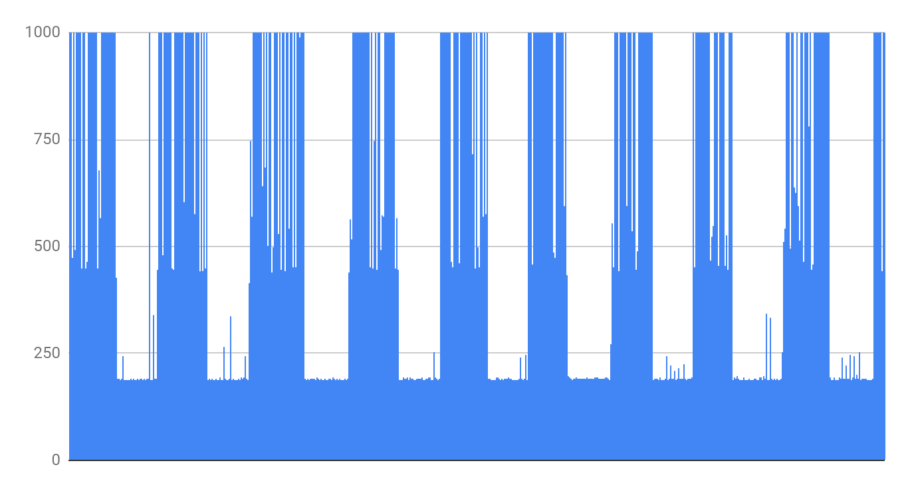
Primary Result: Bandwidth : 20Kb/Sec Error rate: 0.16%
Access Latency
time
Further Bandwidth Improvement:
Transfer multiple bits over different cache set under same kernel launch
Removing kernel launch overhead

Slide 66
Side Channel and Rowhammer
From GPU to CPU:
Challenge: building the timer.

Slide 67
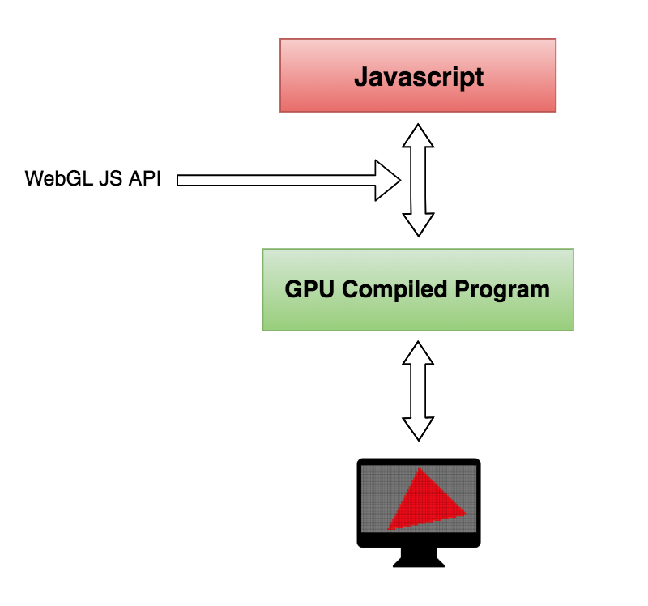
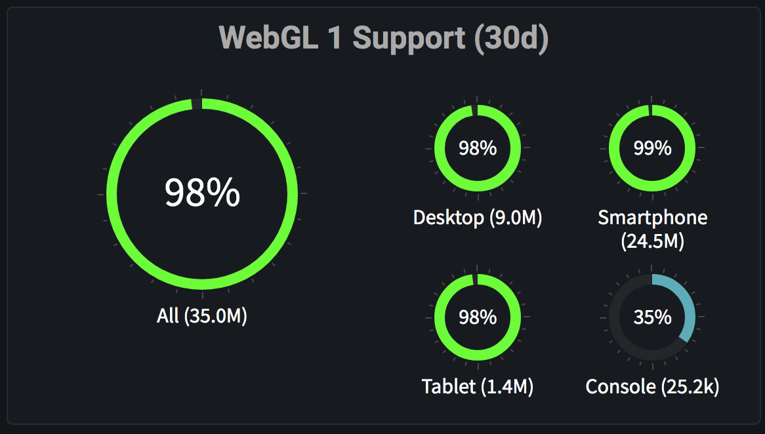
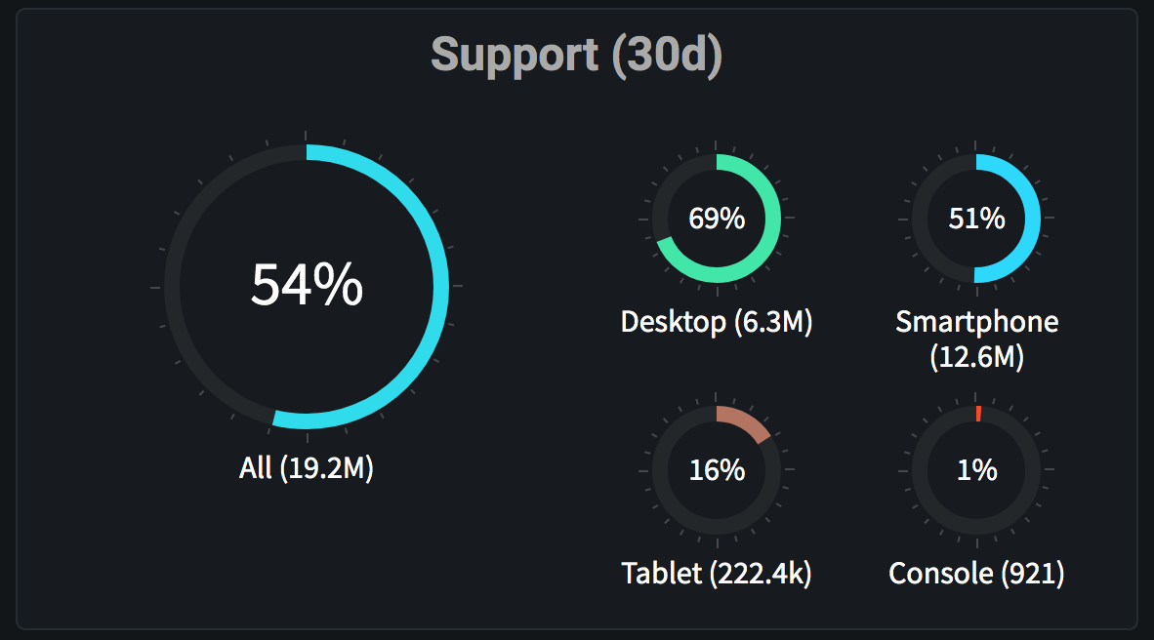
WebGL-Based Attacks
WebGL: A JavaScript API for rendering GPU-accelerated 3D and 2D graphics within web browser (based on OpenGL ES)
WebGL 1 Statistics
WebGL 2 Statistics
https://webglstats.com/

Slide 68
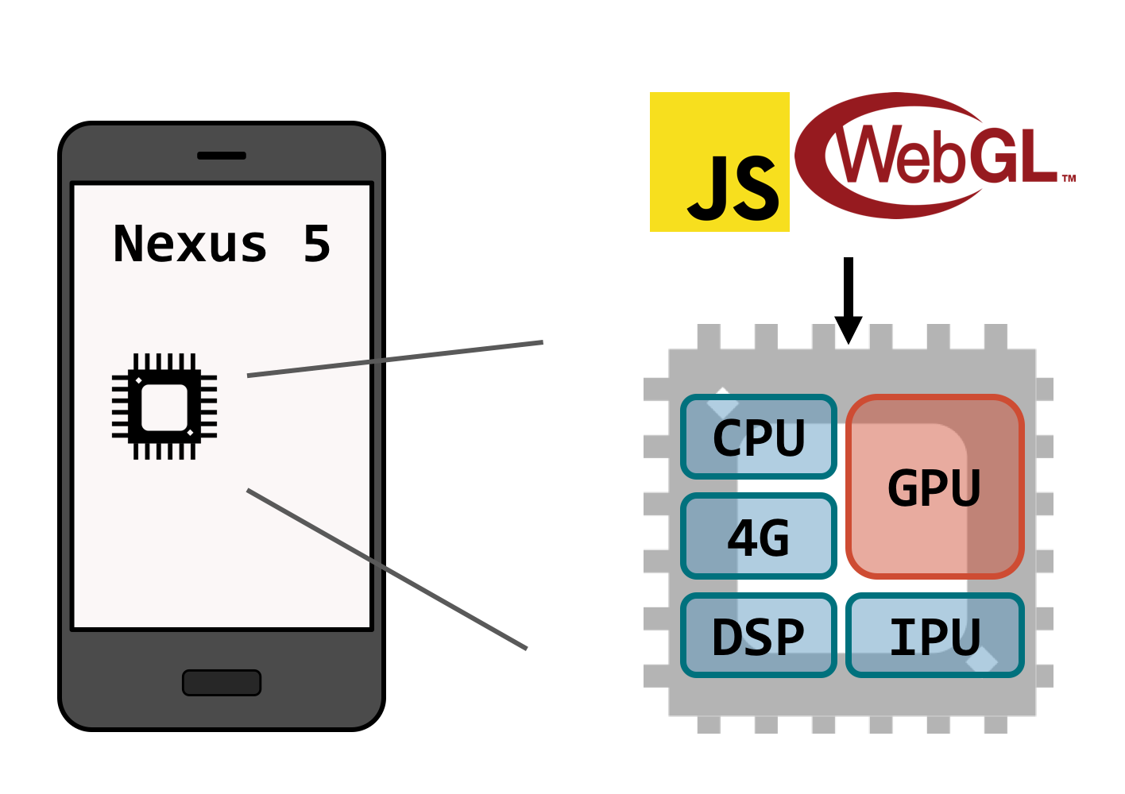
Grand Pwning Unit: Accelerating Microarchitectural Attacks with the GPU Frigo, Giffrida, Bos and Razavi; Vrije Universiteit Amsterdam
S&P 2018
Using GPU as attack vector for end-to-end Rowhammer exploit from JavaScript on ARM
Using WebGL timer
Attack Primitives:
DRAM accesses: Reading texture in fragment shaders
Fast cache eviction: GPU caches are small and deterministic
Contiguous memory: Performing side channel attack on DRAM row buffer to find contiguous area of physical memory
Credit: Frigo et al. S&P 2018
After disclosure, Chrome & Firefox released partial fixes (against timers)

Slide 69
Compute Shader in WebGL (New!)
Ability to use the general-purpose compute functionality.
Many domains: To accelerate machine learning algorithms, for image processing, to improve the rendering quality in game engines, …
Long-term: WebGPU
Short-term: WebGL 2.0 Compute (Based on OpenGL ES 3.1) (Now behind a flag) -- now accessible to developers in Google Chrome Canary by enabling flags

Slide 70
Possible Attack:
Remote (Javascript-based) Side Channel attack: from GPU to CPU applications on Systems with Integrated GPUs.
Re-enabling all previous Javascript-based microarchitectural side channel attacks that have been mitigated, by decreasing the precision of timer, disabling shared memory or ...

Slide 71
Multi-GPU systems:
Reverse Engineering the job scheduler and stablishing Co-location on the same cluster node
Covert and Side Channel Attacks
Denial of Service Attacks
Fault Injection attacks e.g. Rowhammer
Mitigations to provide HPC security

Slide 72
Conclusions
Covert and Side channel attacks possible on GPUs
Security a first order design consideration
We cannot just focus on performance
A lot work needed to characterize threats and understand possible defenses
New computing models-> New attacks
Heterogeneous computing, resource disaggregation, WebGL, …

